Slide 1
Bank Management System
Created By Min Thu Kha

Slide 2
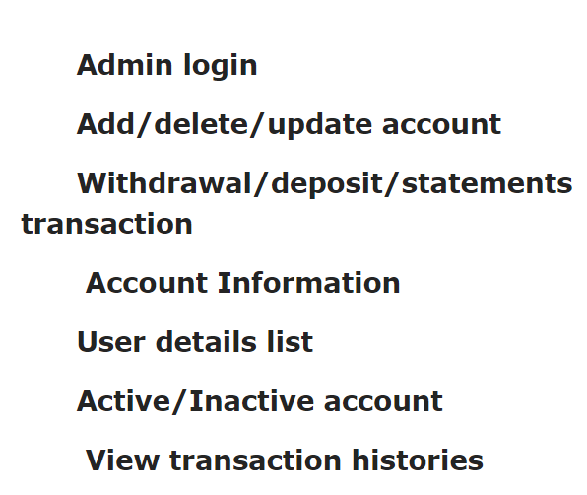
Admin Function

Slide 3
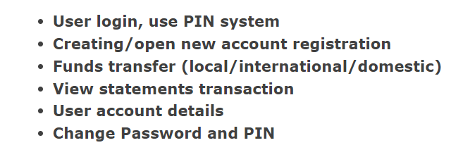
User Function

Slide 4
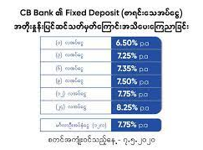
Fixed Deposit
(၁)လအပ်ငွေ | 6.50%
(၃)လအပ်ငွေ | 7.25%
(၆)လအပ်ငွေ | 7.35%
(၉)လအပ်ငွေ | 7.50%
(၁၂)လအပ်ငွေ | 7.75%
(၂၄)လအပ်ငွေ | 8.25%
မင်္ဂလာဦးအပ်နှံငွေ(၁၂)လ | 7.75%

Slide 5
Thanks for watching

